Slide 1
Network Inversion for Uncertainty-Aware Out-of-Distribution Detection
Rehna Afroz Shaik
22B3932
EE451 Supervised Research Exposition(SRE)
IIT Bombay

Slide 2
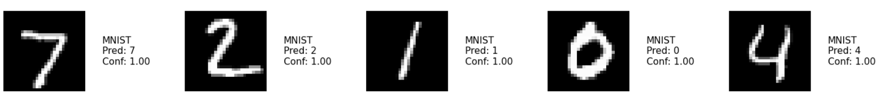
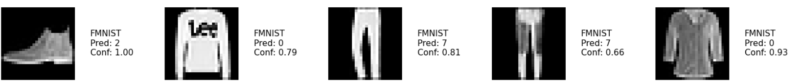
CLASSIFIER
Trained on MNIST dataset
Tested on MNIST and FMNIST datasets
A classifier trained on MNIST digits (0–9) incorrectly classify inputs from FashionMNIST with high confidence

Slide 3
Problem Statement
Classifiers are excellent at distinguishing between in-distribution classes
But often struggle when presented with out-of-distribution (OOD) samples, misclassifying them with high confidence
Need a classifier that not only performs well on training data but can also detect OOD samples
Why Should This Problem Be Solved
Safety: OOD inputs in medical, industrial, or autonomous systems can cause fatal decisions
Generalization: Robust systems should recognize when an input does not belong to the training distribution
Trust: Users need interpretable confidence, uncertainty estimates to trust predictions
Challenges
Need an external OOD dataset to train the classifier for OOD detection
Softmax outputs of the classifier are often overconfident, even for unfamiliar inputs

Slide 4
Previous approaches
“ Autoinverse: Uncertainty Aware Inversion of Neural Networks” (https://arxiv.org/abs/2208.13780v2)
This paper proposes Autoinverse – an automated approach for inverting neural network surrogates.
This approach seeks inverse solutions in the vicinity of reliable data by taking into account the
predictive uncertainty of the surrogate and minimizing it during inversion.
“Uncertainty-Aware Out-of-Distribution Detection with Gaussian Processes ” (https://arxiv.org/pdf/2412.20918) This Paper proposes a Gaussian-process-based method for out-of-distribution detection in deep neural networks (DNNs) that eliminate the need for OOD data during training. This approach includes multi-class Gaussian processes to quantify uncertainty and a score to distinguish in-distribution and OOD samples

Slide 5
Our approach
Our method uses an n+1 approach
n : number of classes present in the training data
Extra ”garbage” class for OOD detection
”Garbage” class is initially populated by samples generated from random Guassian noise
Network inversion to generate OOD samples from the classifier’s input space
Network Inversion
A technique to determine the input from a known output and system mapping, providing insights into Neural networks decision-making

Slide 6
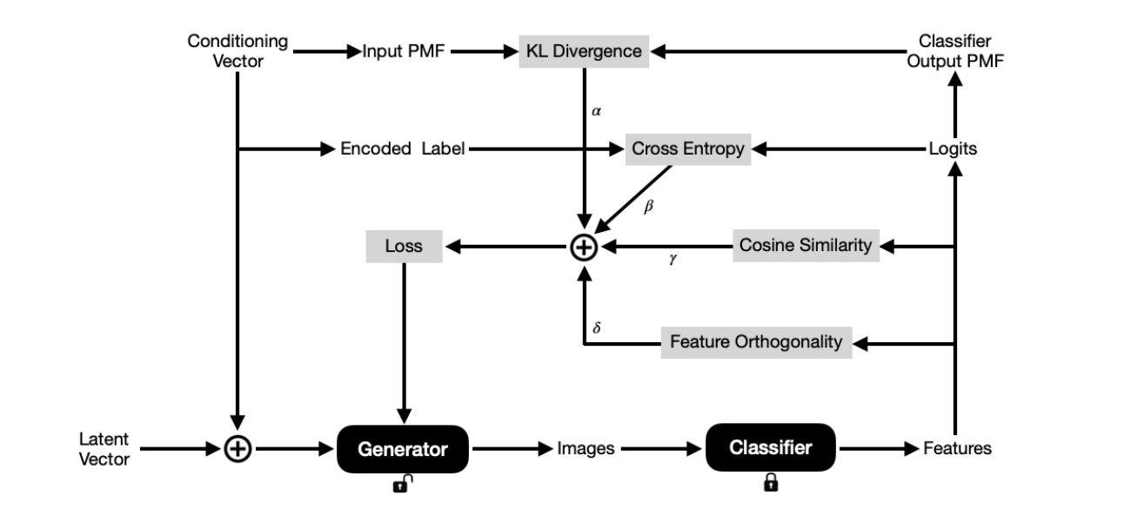
Network Inversion
Network Inversion and its Applications
( https://arxiv.org/pdf/2411.17777)

Slide 7
Our approach
Inversion
Inversion
CLASSIFIER
GENERATOR
Training
Exclusion
DATASET

Slide 8
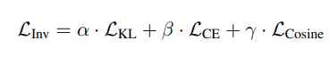
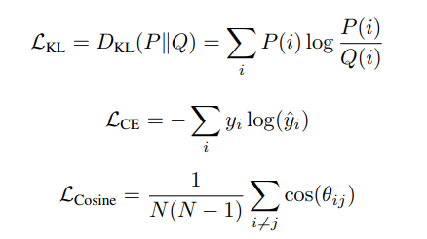
Inversion Loss Function
KL Divergence
Cross Entropy
Cosine Similarity
The hyperparameters α, β, γ control the contribution of each individual loss term
Network Inversion and its Applications (https://arxiv.org/pdf/2411.17777)

Slide 9
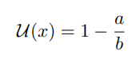
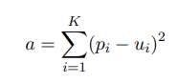
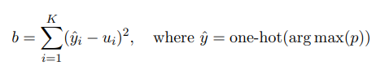
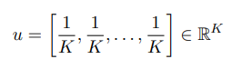
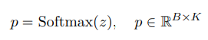
Uncertainty Estimation Method
Uncertainty estimate is given by :
Softmax probabilities
Uniform distribution over K classes
B → Batch size , K → Number of classes
U(x) close to 0 → high confidence
U(x) close to 1 → Maximum Uncertainty

Slide 10
EXPERIMENTS
ARCHITECTURE
CIFAR10, SVHN
Size: 32x32, RGB
Classifier: 5 conv2d + 2 linear
Generator: 4 convTranspose2d
Size: 28x28, GrayScale
Classifier: 3 conv2d + 2 linear
Generator: 4 convTranspose2d
MNIST, FMNIST
Normal Initialization is used for the generator
Vector Conditioning is used for the experiments
Loss: Weighted Cross Entropy
Optimizer: Adam
Datasets used : MNIST, FMNIST, CIFAR10, SVHN, CIFAR100, Tiny ImageNet-200
Trained on one dataset and tested on others as OOD datasets

Slide 11
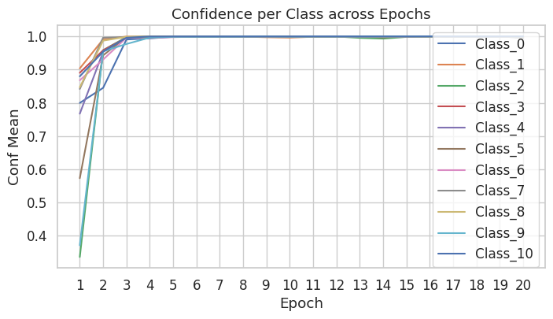
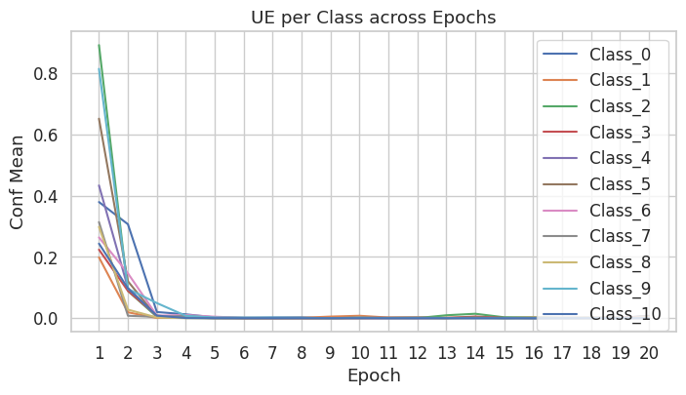
MNIST : In-dist
Hyperparameters and Settings
• Inversion Loss Weights: α = 0 (KL) , β = 1 (CE) , γ = 0 (CS)
• Inversion Steps per Epoch: 100
• Number of samples generated in each step = 11000
Batch Size: 32 , Number of Epochs: 20
Learning Rate:
Classifier: 1e-4
Generator: 1e-3

Slide 12
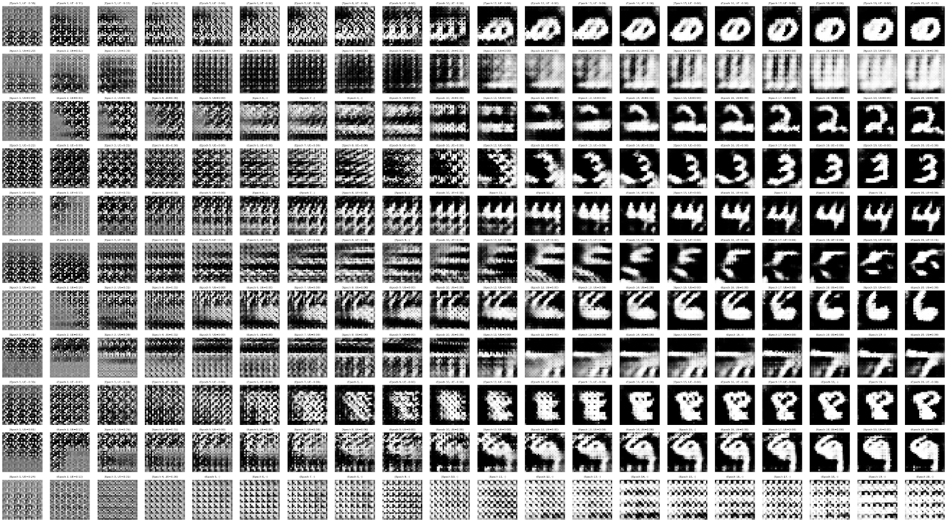
Evolution of generated samples across 20 Epochs

Slide 13
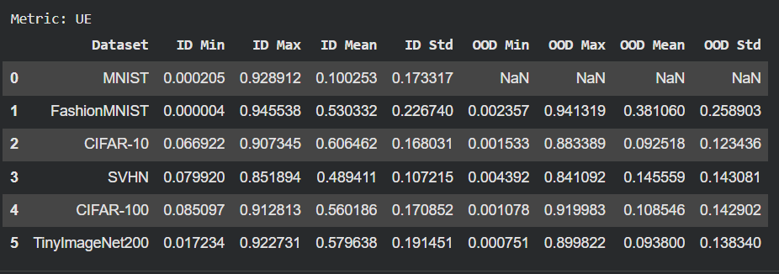
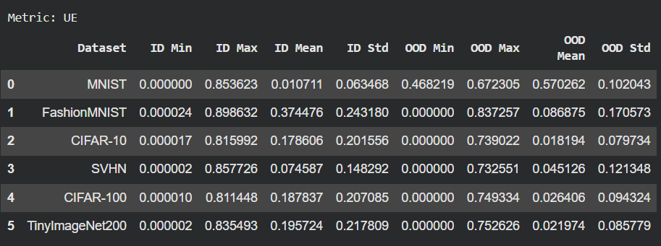
Uncertainty Estimate
Before Inversion
(Classifier trained only for 1 epoch)
( Test Accuracy: 0.9687 )
After Inversion
( Test Accuracy: 0.9915 )

Slide 14
Standard OOD Metrics
AUROC
Probability a random OOD score > random ID score
Independent of any specific threshold
AUPR
Precision–recall curve with OOD treated as positive class
FPR@95TPR
False positive rate when 95% of ID samples are correctly detected.
Lower FPR → better OOD rejection.

Slide 15
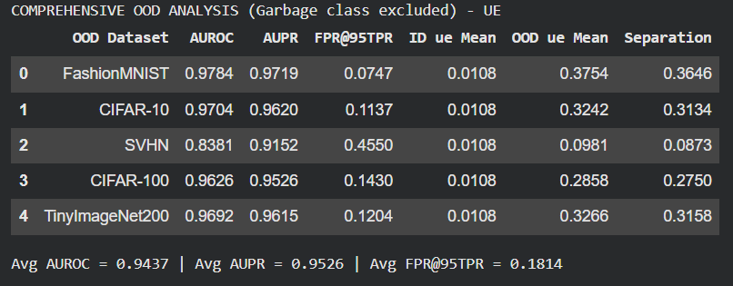
AUROC( ), AUPR ( ), FPR@95TPR ( )
Metric : Uncertainty Estimate

Slide 16
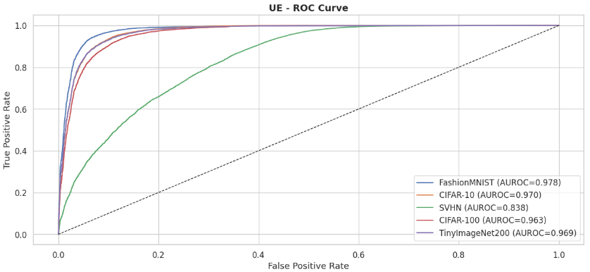
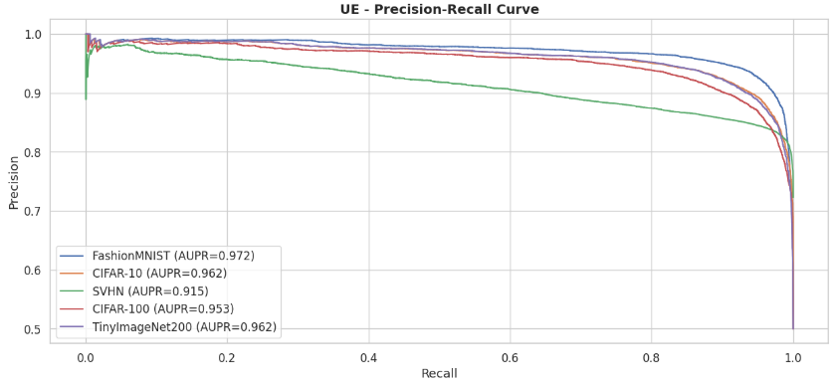

Slide 17
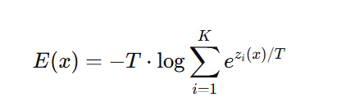
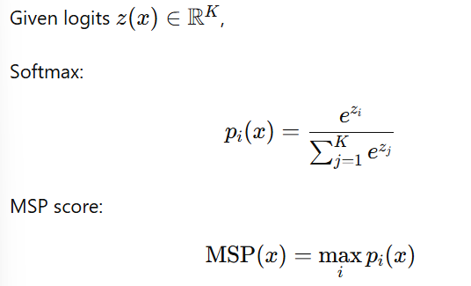
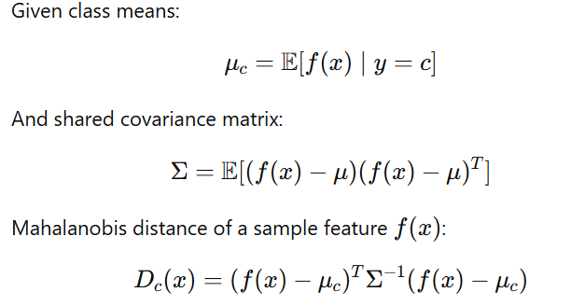
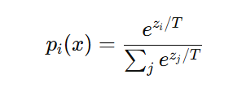
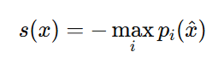
Maximum Softmax Probability
Energy-Based OOD Detection
Mahalanobis Distance
Extract penultimate-layer features
Compute per-class feature mean
Compute shared covariance matrix
Score using Mahalanobis distance
ODIN
(Out-of-Distribution Detector for Neural Networks)

Slide 18
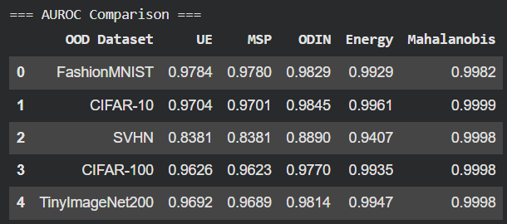
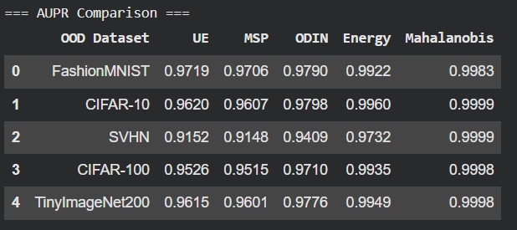
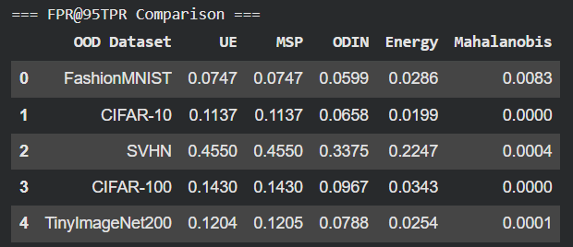
Comparison of AUROC, AUPR and FPR@95TPR for different OOD detection methods

Slide 19
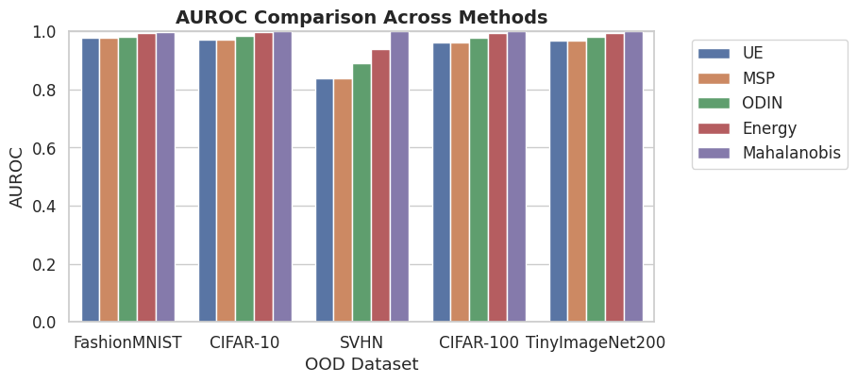
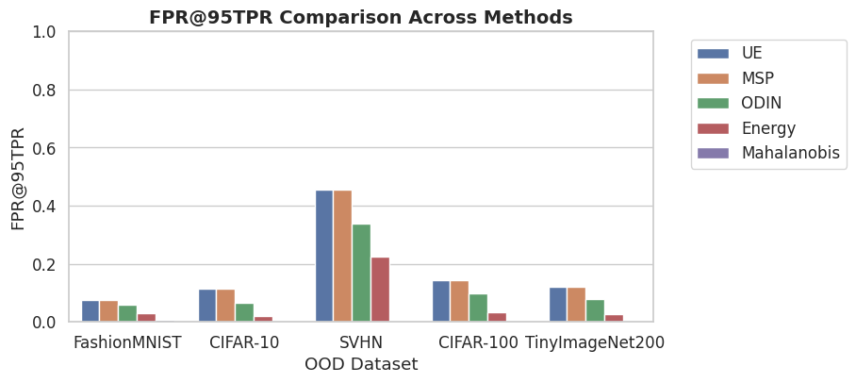
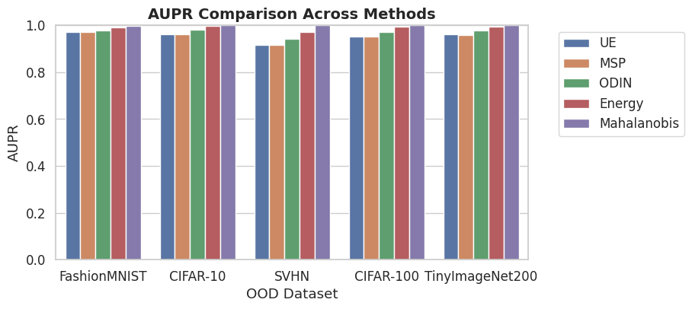

Slide 20
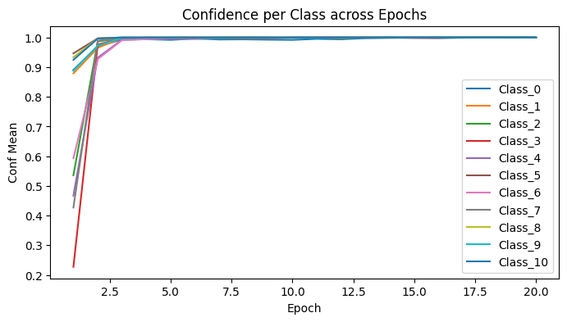
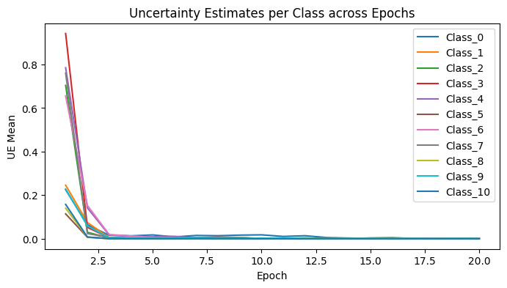
FMNIST : In-dist
Hyperparameters and Settings
• Inversion Loss Weights: α = 0, β = 1, γ = 0
• Inversion Steps per Epoch: 100
• Number of samples generated in each step = 11000
Batch Size: 32 , Number of Epochs: 20
Learning Rate:
Classifier: 1e-4
Generator: 1e-3

Slide 21
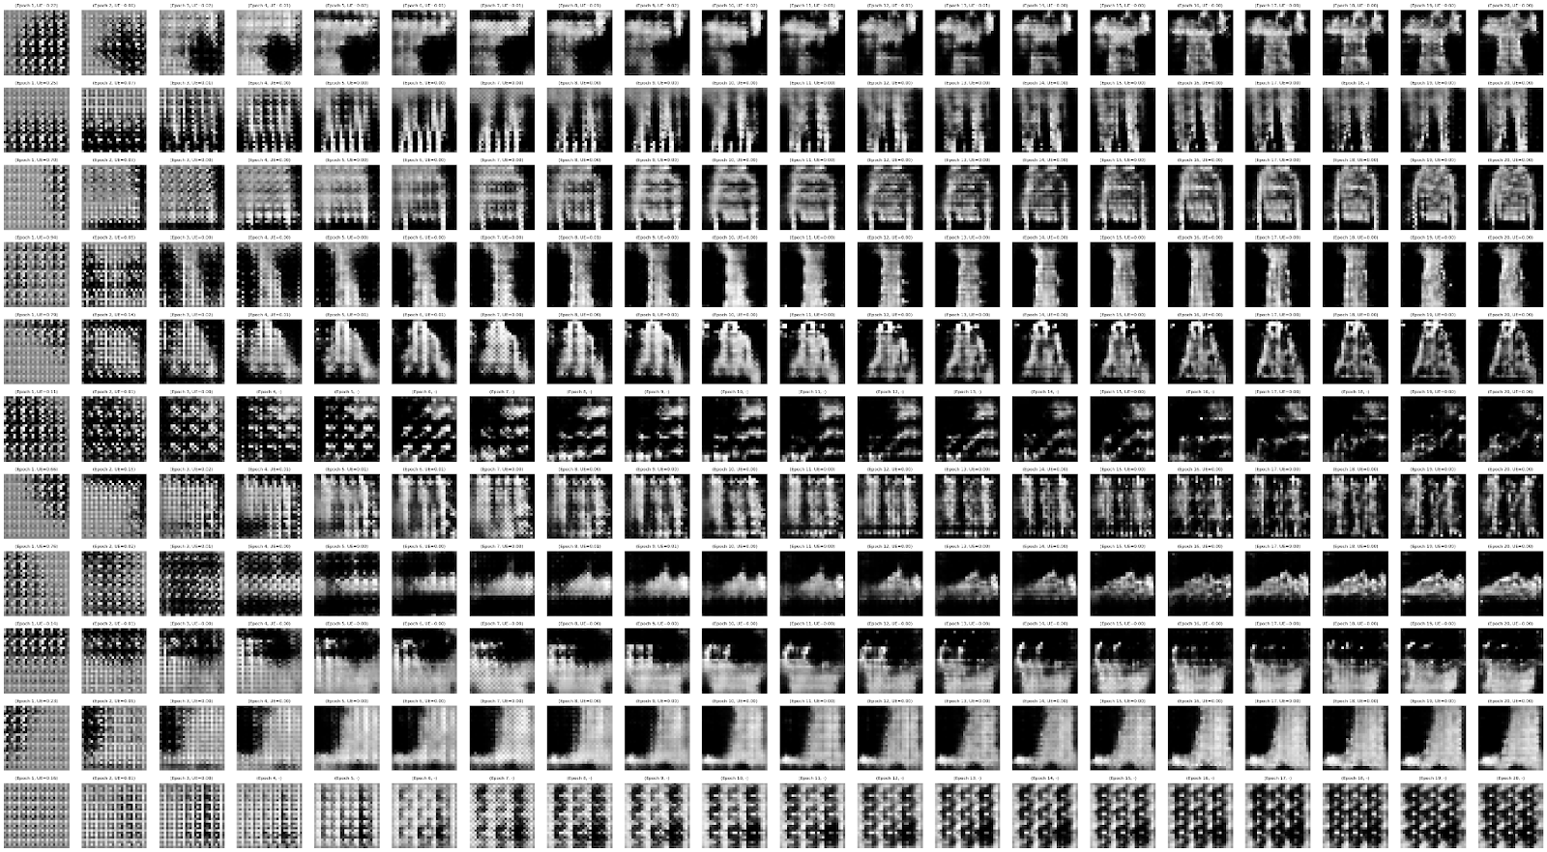
Evolution of generated samples across 20 Epochs

Slide 22
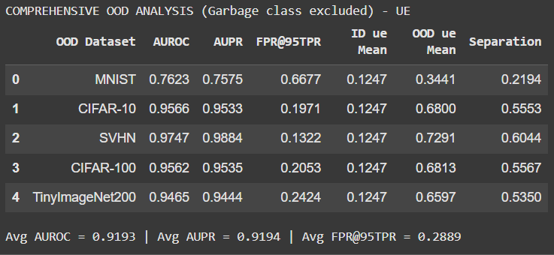
AUROC, AUPR, FPR@95TPR Metric : Uncertainty Estimate

Slide 23
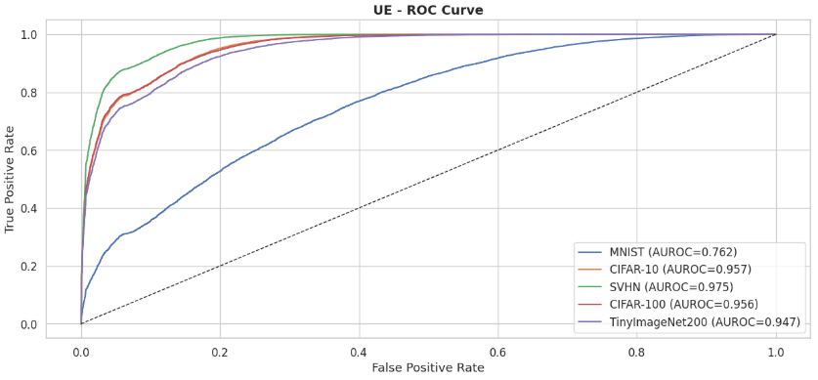
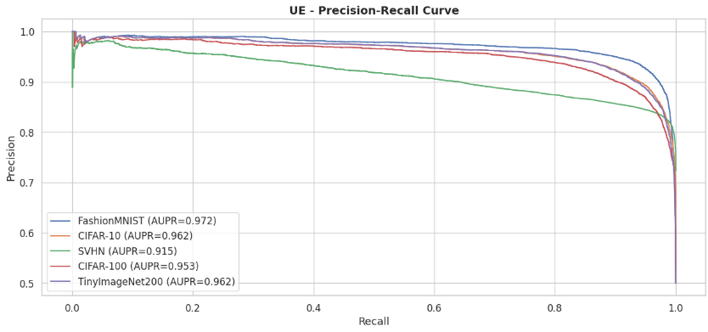

Slide 24
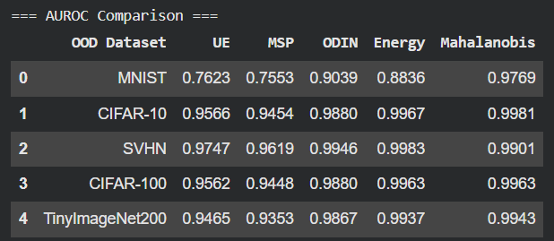
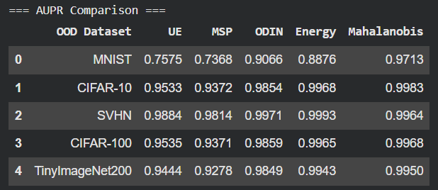
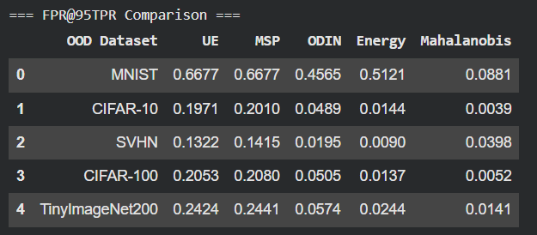
Comparison of AUROC, AUPR and FPR@95TPR for different OOD detection methods

Slide 25
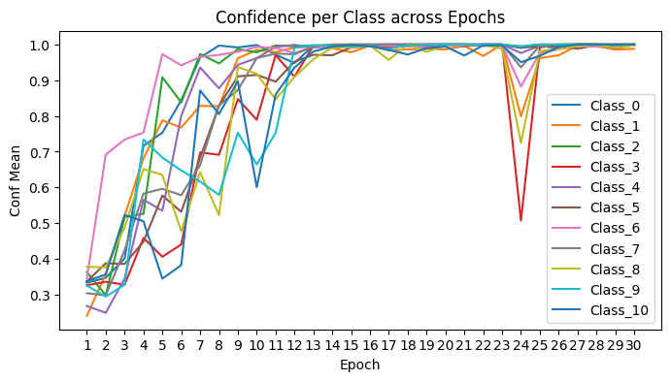
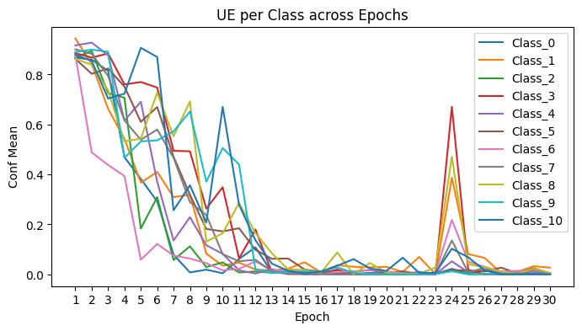
SVHN : In-dist
Hyperparameters and Settings
• Inversion Loss Weights: α = 0, β = 1, γ = 10
• Inversion Steps per Epoch: 90
• Number of samples generated in each step = 11000
Batch Size: 32 , Number of Epochs: 30
Learning Rate:
Classifier: 1e-3
Generator: 1e-3

Slide 26
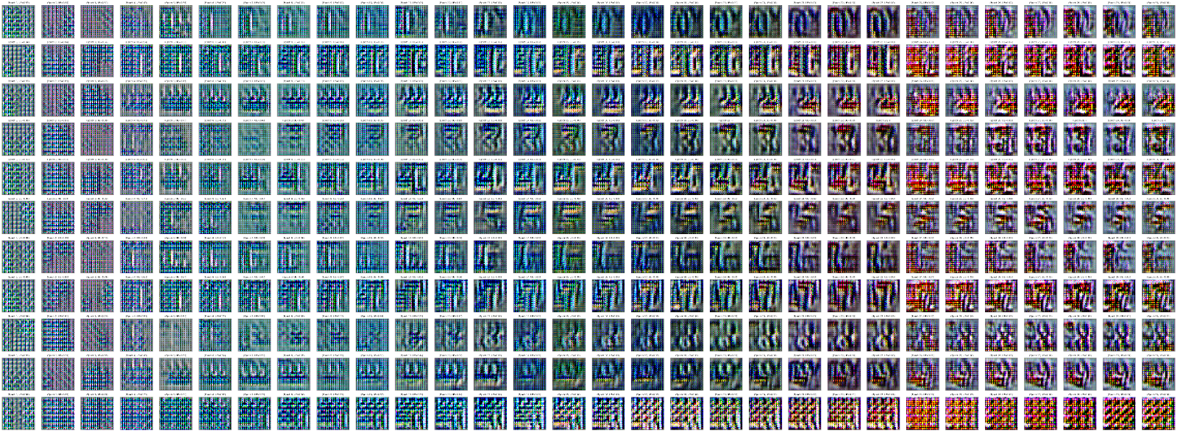
Evolution of generated samples across 30 Epochs

Slide 27
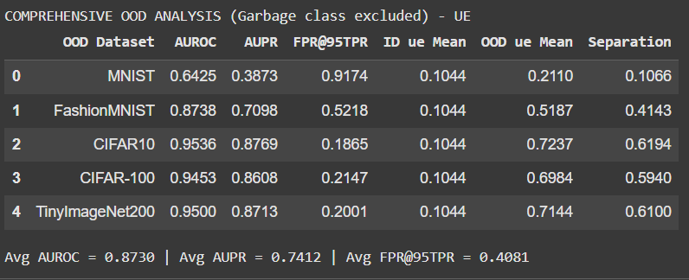
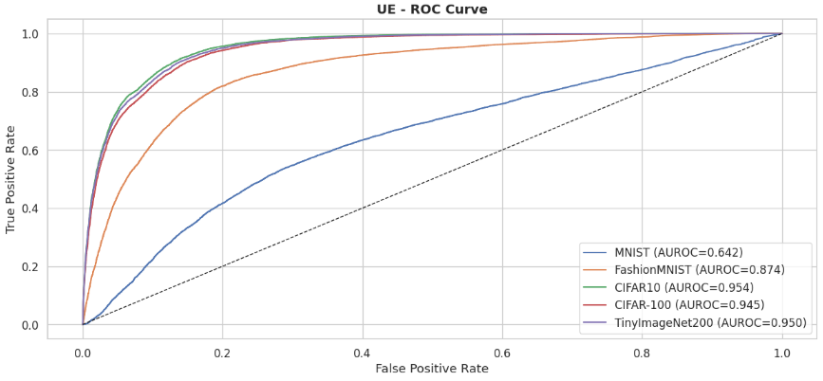
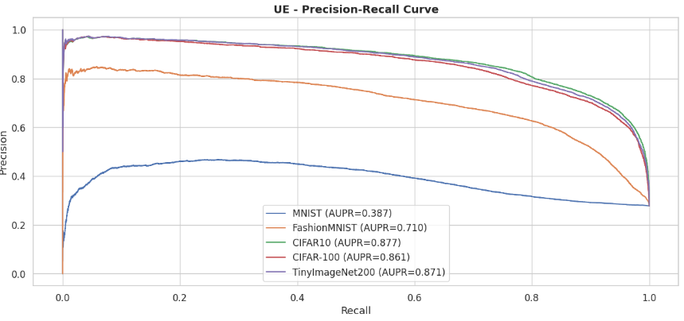
AUROC, AUPR, FPR@95TPR Metric : Uncertainty Estimate

Slide 28
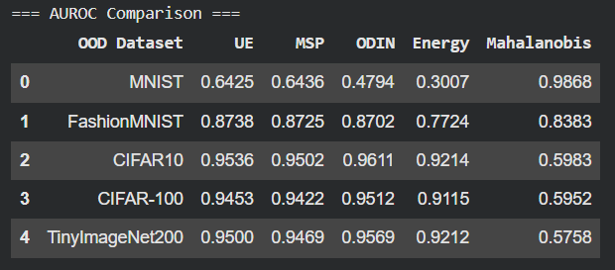
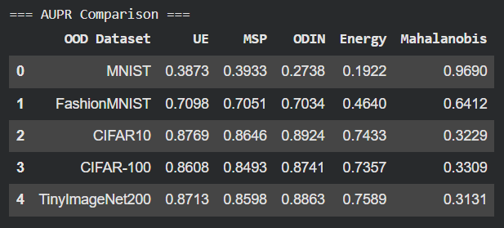
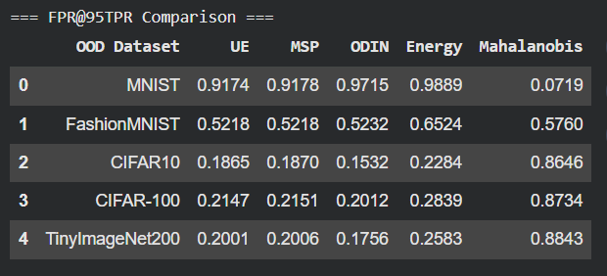
Comparison of AUROC, AUPR and FPR@95TPR for different OOD detection methods

Slide 29
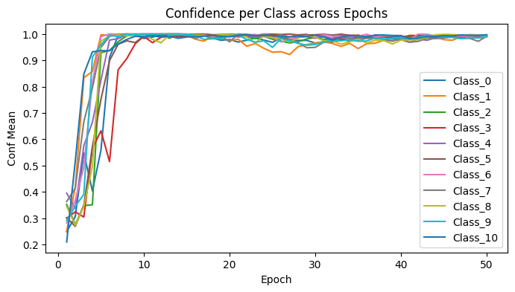
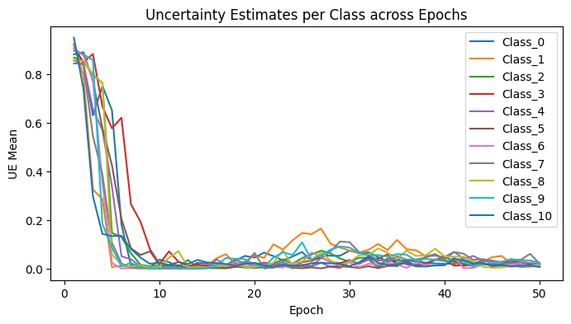
CIFAR10 : In-dist
Hyperparameters and Settings
• Inversion Loss Weights: α = 0, β = 1, γ = 100
• Inversion Steps per Epoch: 100
• Number of samples generated in each step = 11000
Batch Size: 32 , Number of Epochs: 41
Learning Rate:
Classifier: 1e-4
Generator: 1e-3

Slide 30
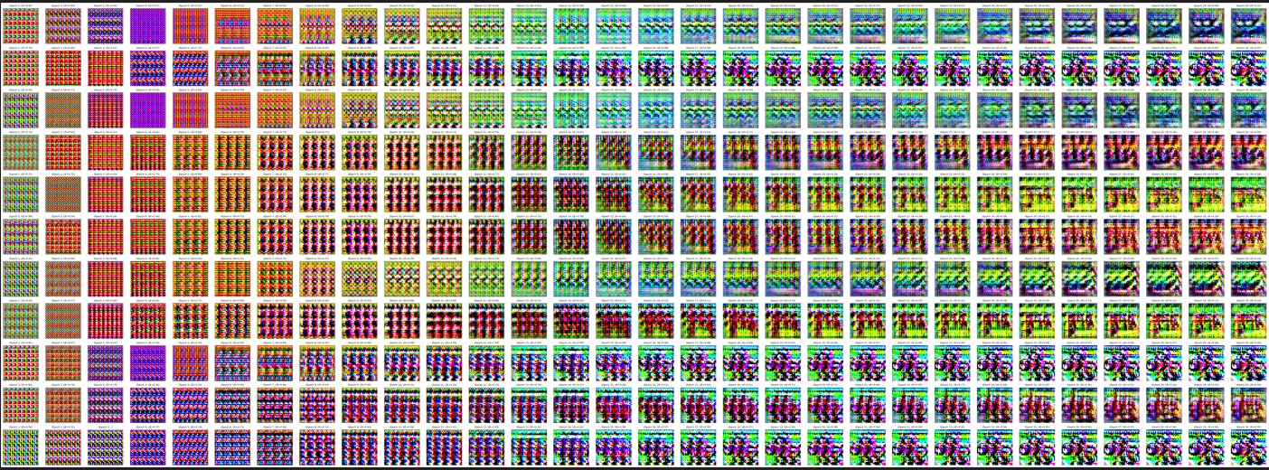
Evolution of generated samples across 30 Epochs

Slide 31


AUROC, AUPR, FPR@95TPR Metric : Uncertainty Estimate

Slide 32

Comparison of AUROC, AUPR and FPR@95TPR for different OOD detection methods

Slide 33
Conclusion & Future Work
Across all experiments, network inversion consistently achieved high AUROC, AUPR on OOD datasets
Future work can also consider the use n garbage classes—one for each of the in-distribution classes—for fine-grained separation of OOD samples and weighted individual OOD sample contribution to the loss while retraining the classifier based on uncertainty

Slide 34
THANK YOU

